Slide 1
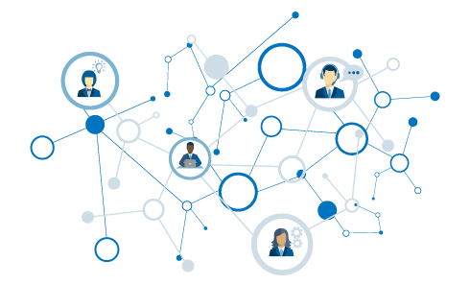
Popular Pythonistas
What is a network?
Using graphs
Ranking MeetUp groups
Ranking MeetUp people

Slide 2
Notes:
* You're new to Nashville. You're ready to start meeting people, making friends, expanding your network. But you don't want to get pigeon-holed into just one group, i.e. the people you might already know / are comfortable with. Maybe you're trying to market yourself / a product.
* What groups should you join? Who should you talk to in those groups? Wouldn't you rather be invited into a group than just show up at one?

Slide 3
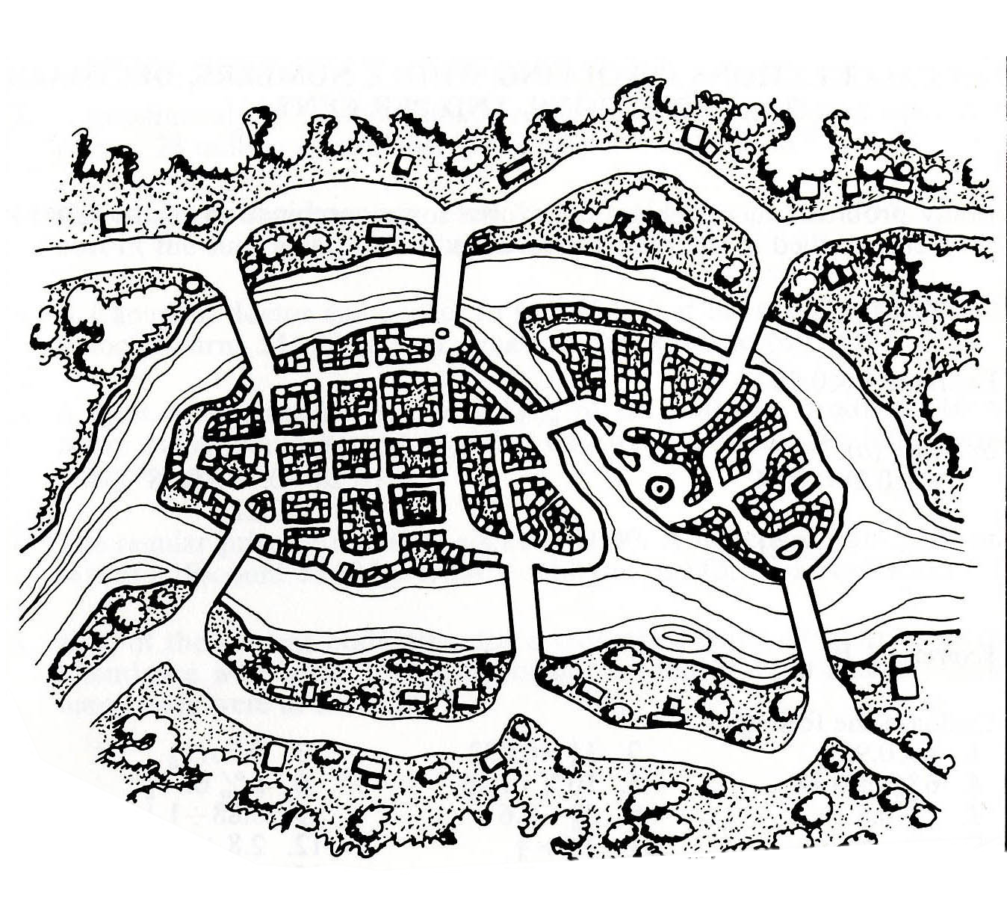
Can you traverse every bridge just once?
2
1
3
4
5
6
7

Slide 4
2
1
3
4
5
6
7

Slide 5
A
2
1
3
C
B
4
5
6
7
D

Slide 6
A
2
1
3
C
B
4
5
6
7
D

Slide 7
Graph
A
Node
B has the most connections
B
C
Edge
D
A & D are on the “outside” – they are not connected to each other
Notes:
Without knowing anything about this system, what is one thing you might say?
B seems to be the most “important” place – has the most connections.
B and C are seem to be more central to the graph – A and D are both on the edges

Slide 8
1
1
To travel into AND out of a node, requires 2 steps (or 4 or 6…).
Therefore… either:
All nodes are even.
Exactly two nodes are odd.
2
2
1
3
2
Notes:
Without knowing anything about this system, what is one thing you might say?
B seems to be the most “important” place – has the most connections.
B and C are seem to be more central to the graph – A and D are both on the edges

Slide 9
Four nodes with odd number of edges!
3
5
3
3
Notes:
Without knowing anything about this system, what is one thing you might say?
B seems to be the most “important” place – has the most connections.
B and C are seem to be more central to the graph – A and D are both on the edges

Slide 10
That’s the ticket…
3
4
3
2
Notes:
Without knowing anything about this system, what is one thing you might say?
B seems to be the most “important” place – has the most connections.
B and C are seem to be more central to the graph – A and D are both on the edges

Slide 11
Identifying Nashville’s Popular Pythonistas with NetworkX
November 16, 2017
Stephen Bailey

Slide 12
Graphs
Useful for understanding relationships.
Describe topology (arrangement) of networks.

Slide 13
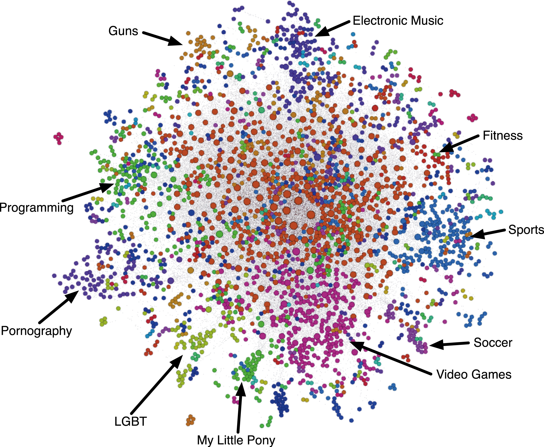
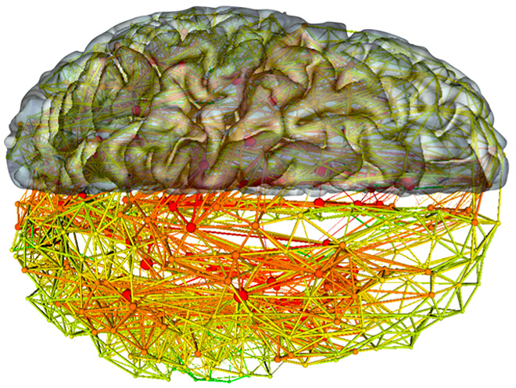
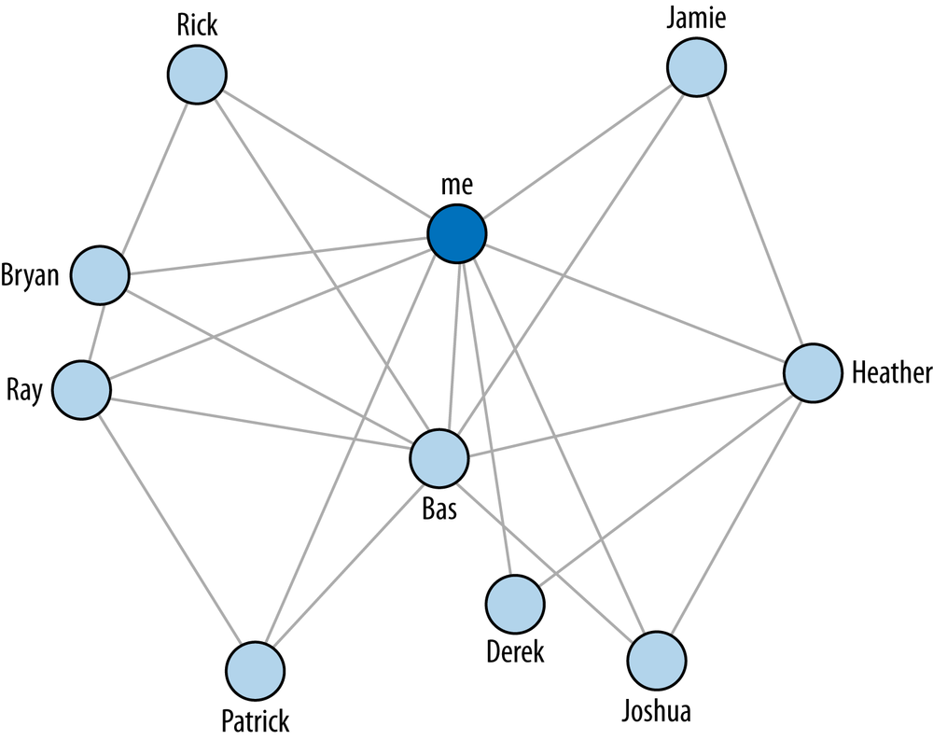
Notes:
Without knowing anything about this system, what is one thing you might say?
B seems to be the most “important” place – has the most connections.
B and C are seem to be more central to the graph – A and D are both on the edges

Slide 14
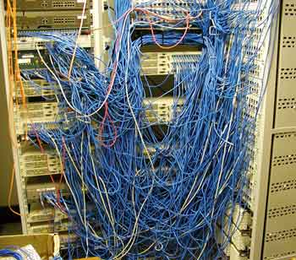
Identifying a network problem
Good way to make sense of multivariate data
Centrality
Influence
Mapping
Recommendations

Slide 15
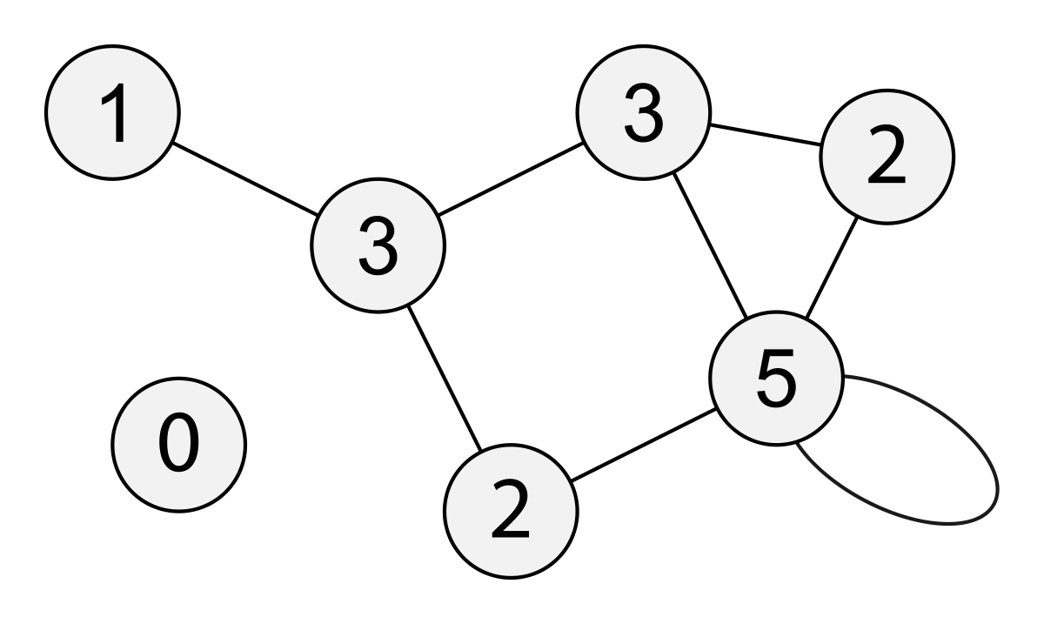
Common Measures
Degree
Notes:
Path length – average

Slide 16
Common Measures
Degree
Path Length
Notes:
Path length – average

Slide 17
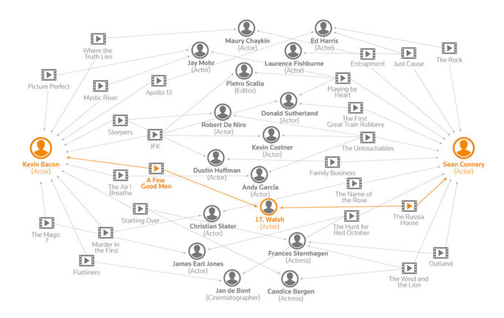

Slide 18
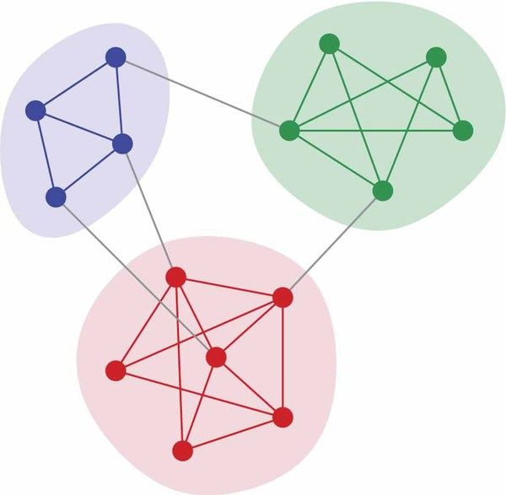
Common Measures
Degree
Path Length
Clustering
Notes:
Path length – average

Slide 19
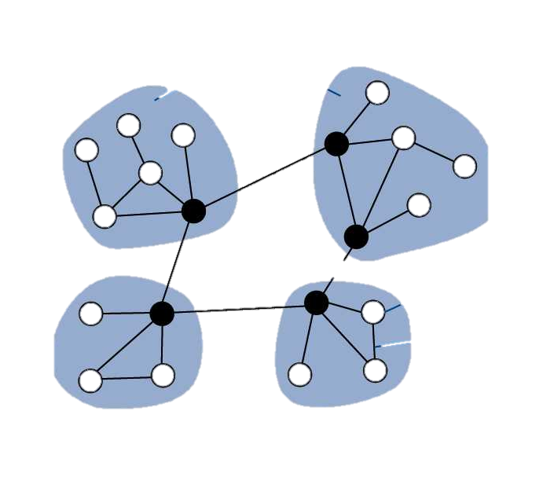
Common Measures
Degree
Path Length
Clustering
Centrality
Notes:
Path length – average

Slide 20
Now, to PyNash….

Slide 21
The MeetUp Data
Used MeetUp API to get the following information:
All groups within 25 miles of Nashville.
All members of those groups.
All events for each group and who RSVPed yes.
(On Github)

Slide 22
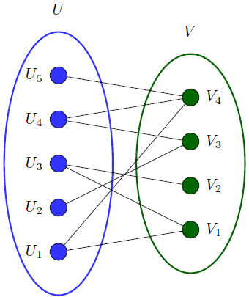
Bipartite Graphs
Great initial starting place for some datasets.
Can take the form of (Person node → Affiliation node)
e.g. (Sports fan → Sports team)

Slide 23
PyNash Relationships
We have >1400 members. But not all of them come to every meeting. (And many don’t come to any meetings.)
So

Slide 24
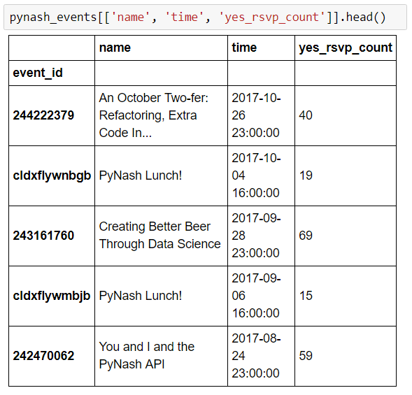
Events

Slide 25
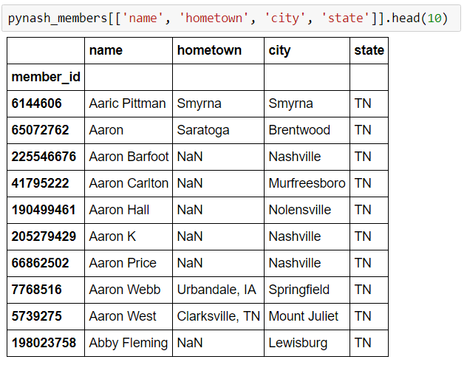
Members

Slide 26
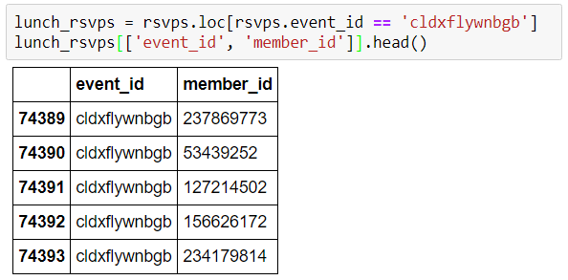
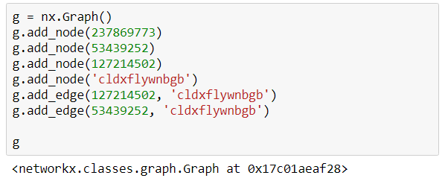
Building the graph

Slide 27
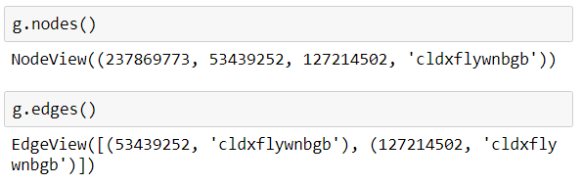
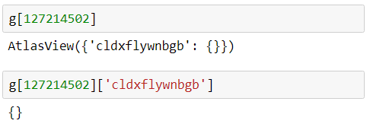
Building the graph
Graphs are setup as dicts-of-dicts-of-dicts.
Source: Target: Attrs

Slide 28
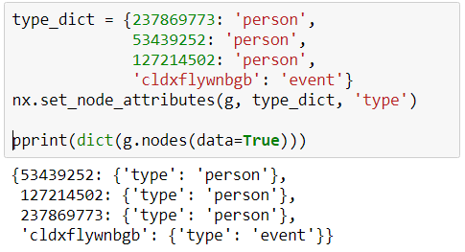
Building the graph
Graphs are setup as dicts-of-dicts-of-dicts.
Source: Target: Attrs

Slide 29
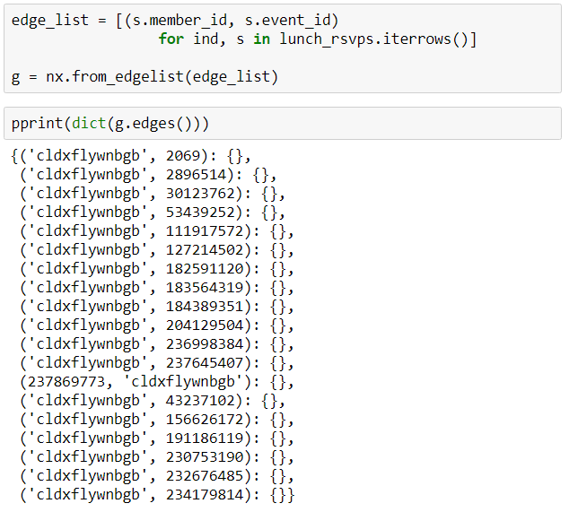
Building the graph
Graphs are setup as dicts-of-dicts-of-dicts.
Source: Target: Attrs

Slide 30
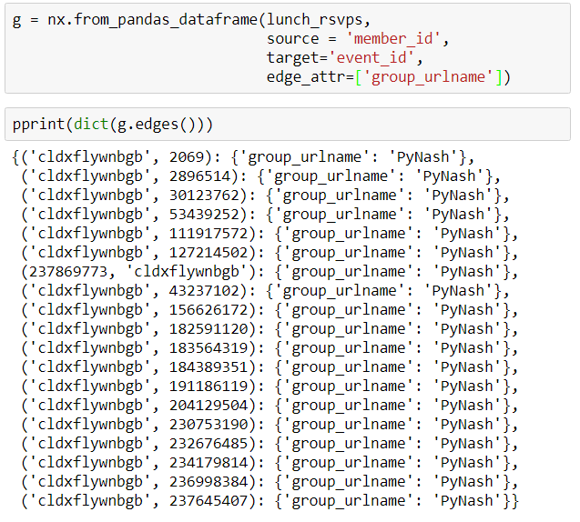
Building the graph
Graphs are setup as dicts-of-dicts-of-dicts.
Source: Target: Attrs

Slide 31
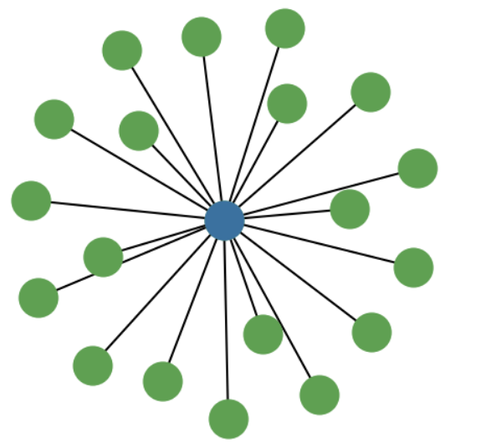

Slide 32
Project Bipartitate Graphs (Person, Event) to (Person, Person)
We want to take

Slide 33
The final product
Now we have a graph with the following attributes:
Node: a person who attended at least one event in the past two years
Edge: shared event between two people
Edge weight: the number of shared events

Slide 34
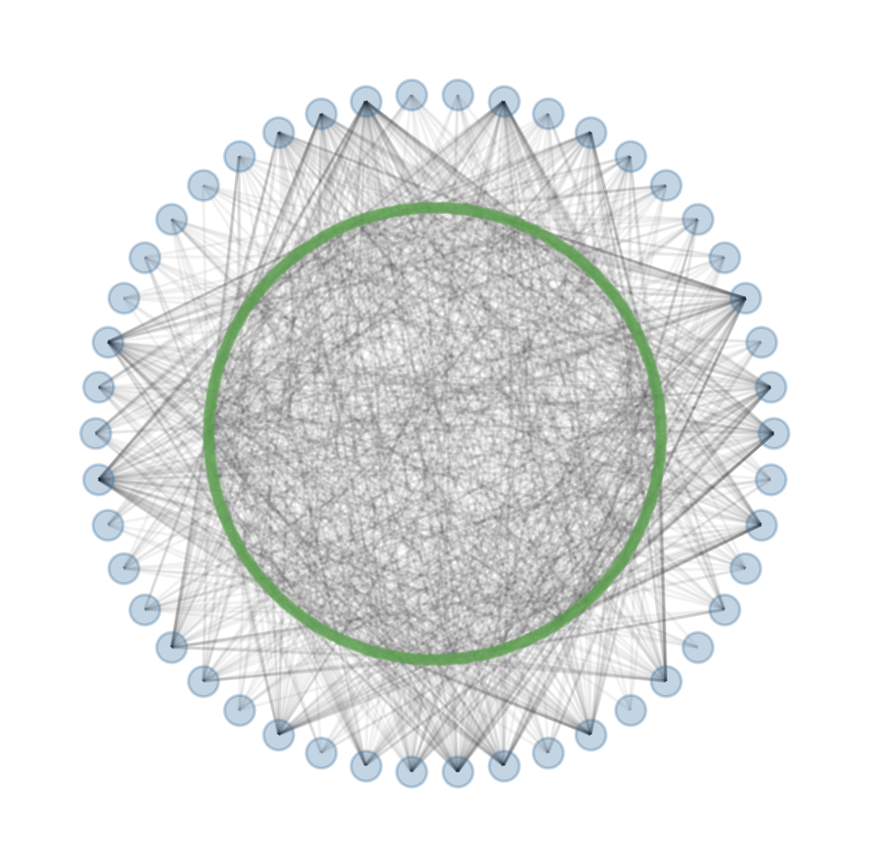

Slide 35
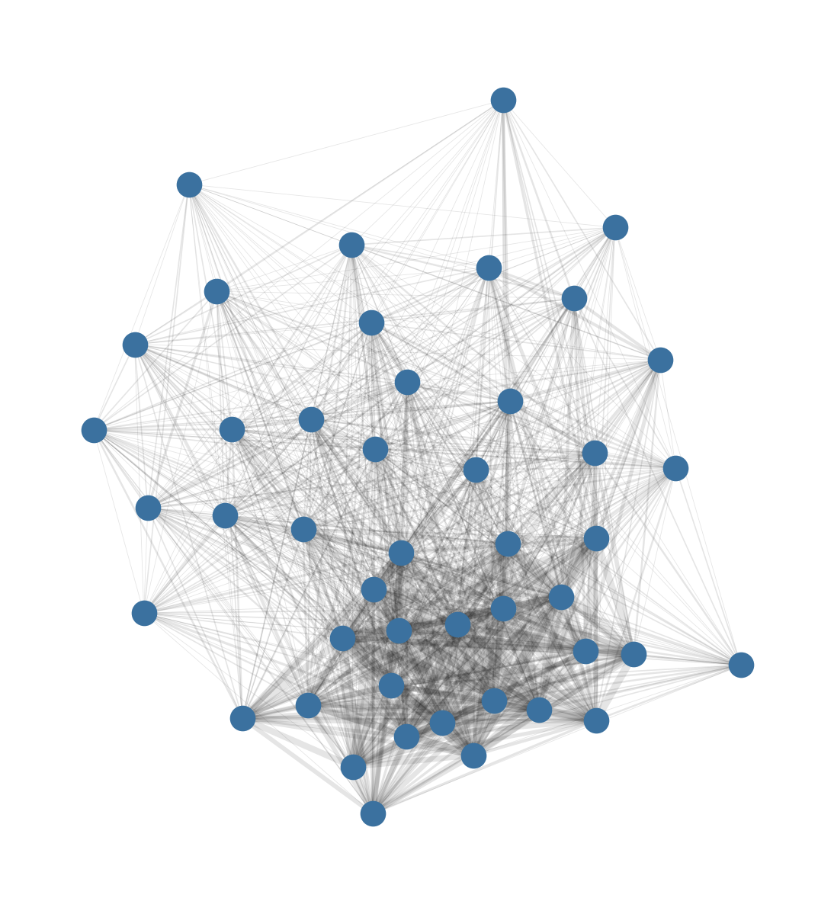

Slide 36
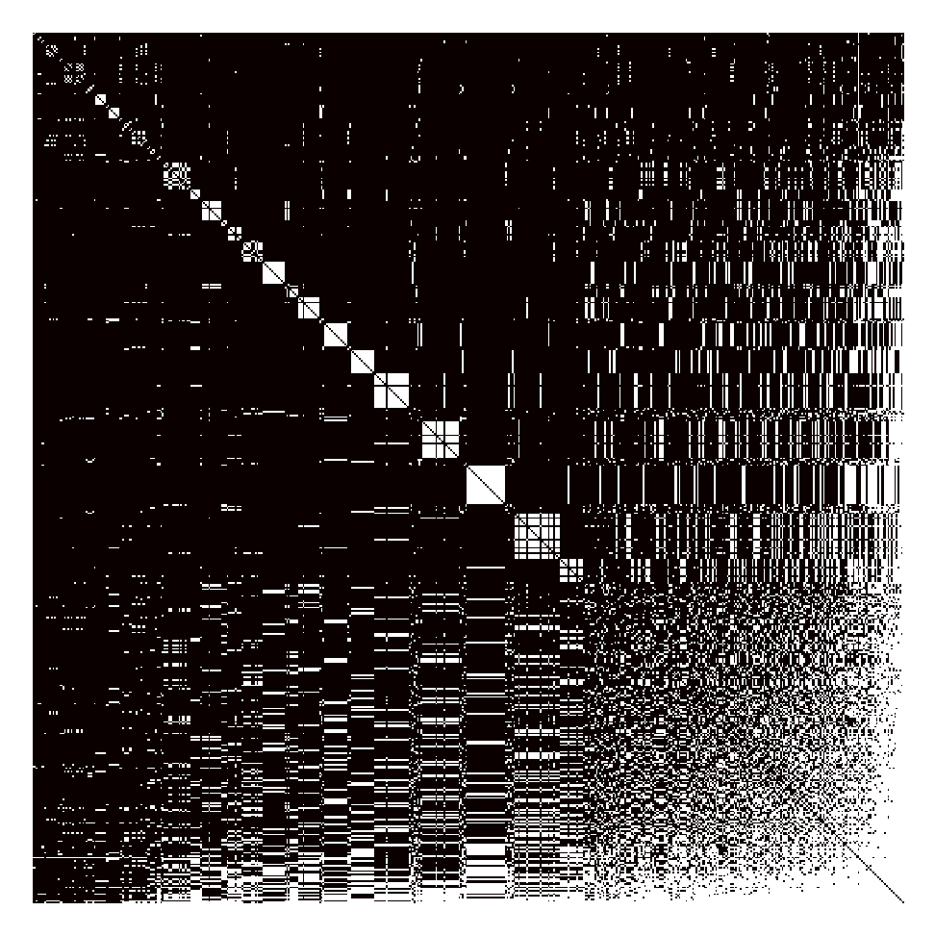
Adjacency Matrix
Matrix representation of graph edges
N*N binary array

